Slide 1
LIBRARY MANAGEMENT SYSTEM
Presented by:
md. ZUBAER Hossain
20171077010

Slide 2
Introduction:
This project implements a digital library management system.
It aims to make the use of library user friendly and easier.
It aims to reduce the time consumed for finding a book and the work load of the library staff.
LIBRARY MANAGEMENT SYSTEM

Slide 3
ABSTRACT:
This project aims to develop a LAN based desktop application.
It has provisions for----------->>
Registration to new student
Users to search and preview books
Know availability of books
Request for new books
View their records
Delete of a book record
LIBRARY MANAGEMENT SYSTEM

Slide 4
HARDWARE & SOFTWARE SPECIFICATIONS:
SOFTWARE USED:
Operating system : Windows 10
Data Base : SQL Server Management Studio 2012
IDE : Microsoft Visual Studio 2019
Image Design: Adobe Photoshop
LIBRARY MANAGEMENT SYSTEM

Slide 5
BACKGROUND SPECIFICATIONS:
Programming Language : C Sharp (C#)
Design Language: XAML (Extensible Application Markup Language)
Windows Format: WPF (Windows Presentation Foundation)
Database Language: SQL (Structured Query Language)
LIBRARY MANAGEMENT SYSTEM

Slide 6
HARDWARE & SOFTWARE SPECIFICATIONS:
HARDWARE USED
Processor : Intel core i5
Memory size : 8 GB of RAM
Input : Mouse/Keyboard/touch
LIBRARY MANAGEMENT SYSTEM

Slide 7
SYSTEM STUDY
LIBRARY MANAGEMENT SYSTEM

Slide 8
EXISTING SYSTEM:
Any information regarding a book, its availability or cost has to be gained from the librarian.
Users have to browse the library manually to find a book with required content.
No provision for the users to request new books.
In short the existing system has a lot of disadvantages.
Limited knowledge.
Less interaction.
Time consuming.
LIBRARY MANAGEMENT SYSTEM

Slide 9
PROPOSED SYSTEM:
The application can search for all the books by a book name, preview their contents and know if it received from Library by students, when it will be available for back.
The proposed systems aims to overcome drawbacks of existing system and:
Reduce time and effort required to find books.
Make the use of library user friendly and efficient.
Improve efficiency and quality of service.
Make more books available for accept to students in the long term by completely digitalizing the reference section.
LIBRARY MANAGEMENT SYSTEM

Slide 10
ADMINISTRATOR MODULE:
Login
Manage Requests
Manage New Book Issue
Manage Books
Details Of current status of books
Information about books
Manage Student Books
LIBRARY MANAGEMENT SYSTEM

Slide 11
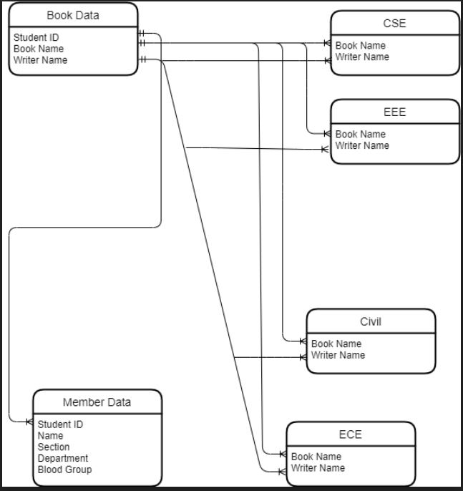
ER Diagram:
LIBRARY MANAGEMENT SYSTEM

Slide 12
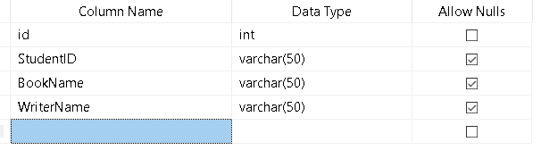
TABLES:
There are seven data tables used.
Student Book Record:
[Table Name: BookData ]
LIBRARY MANAGEMENT SYSTEM

Slide 13
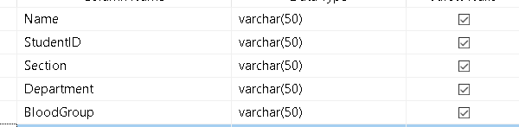
TABLES:
2. Member Registration:
[Table Name: memberData]
LIBRARY MANAGEMENT SYSTEM

Slide 14
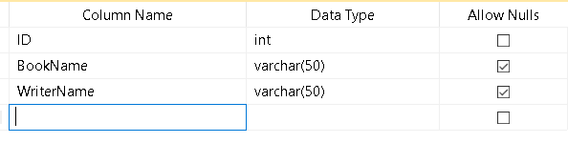
TABLES:
3. CSE Book Record:
[Table Name: CSE]
LIBRARY MANAGEMENT SYSTEM

Slide 15
TABLES:
EEE Book Record:
[Table Name: EEE]
LIBRARY MANAGEMENT SYSTEM

Slide 16
TABLES:
Civil Book Record:
[Table Name: Civil]
LIBRARY MANAGEMENT SYSTEM

Slide 17
TABLES:
6. ECE Book Record:
[Table Name: ECE]
LIBRARY MANAGEMENT SYSTEM

Slide 18
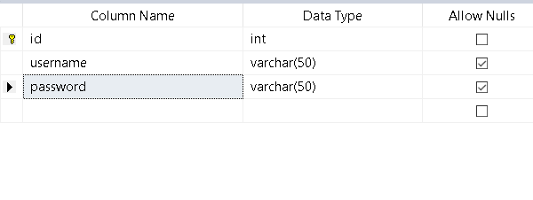
TABLES:
Admin Authentication :
[Table Name: users ]
LIBRARY MANAGEMENT SYSTEM

Slide 19
SCREENSHOTS
LIBRARY MANAGEMENT SYSTEM

Slide 20
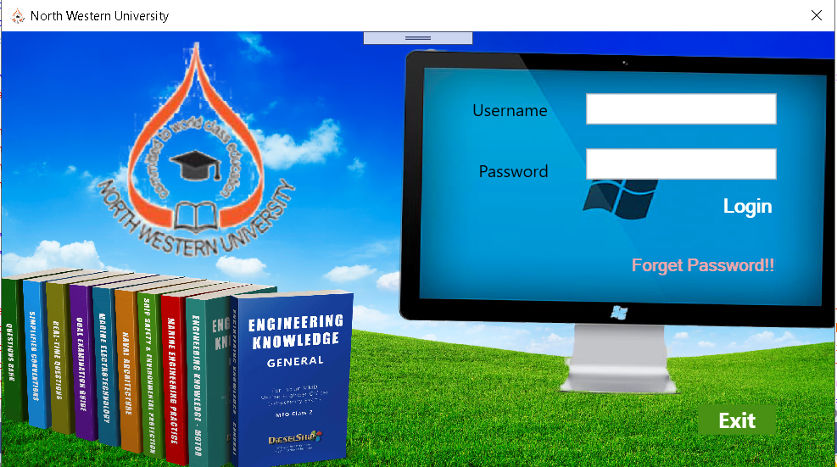
Admin Log In Window:
LIBRARY MANAGEMENT SYSTEM

Slide 21

Dashboard Window:
LIBRARY MANAGEMENT SYSTEM

Slide 22
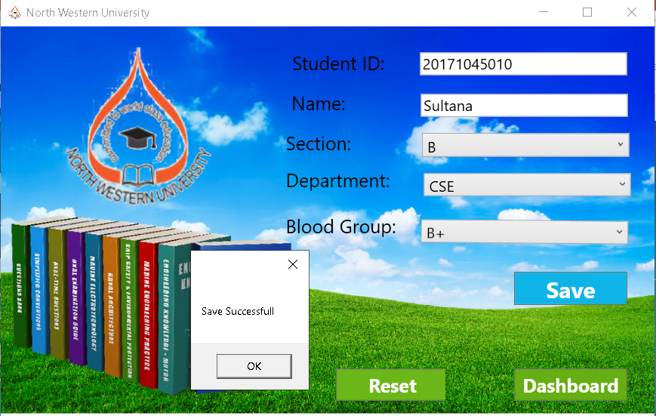
Student Registration Window:
LIBRARY MANAGEMENT SYSTEM

Slide 23
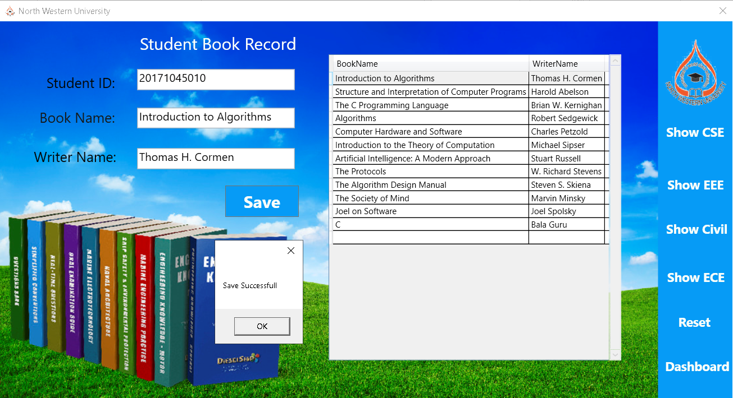
Add Student Book Window:
LIBRARY MANAGEMENT SYSTEM

Slide 24
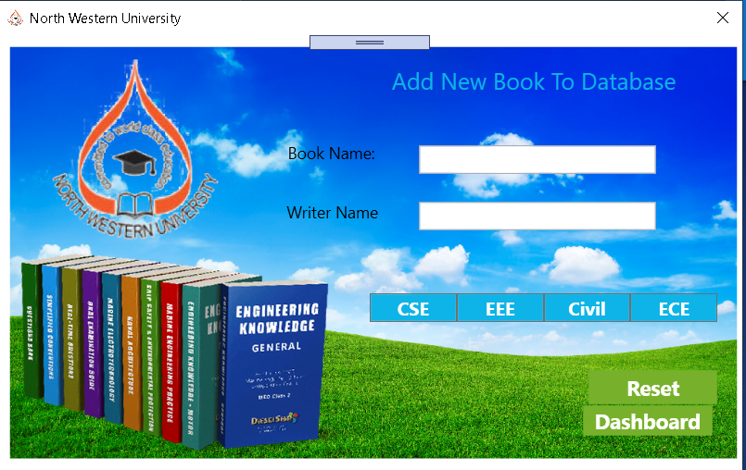
Add New Book Window:
LIBRARY MANAGEMENT SYSTEM

Slide 25
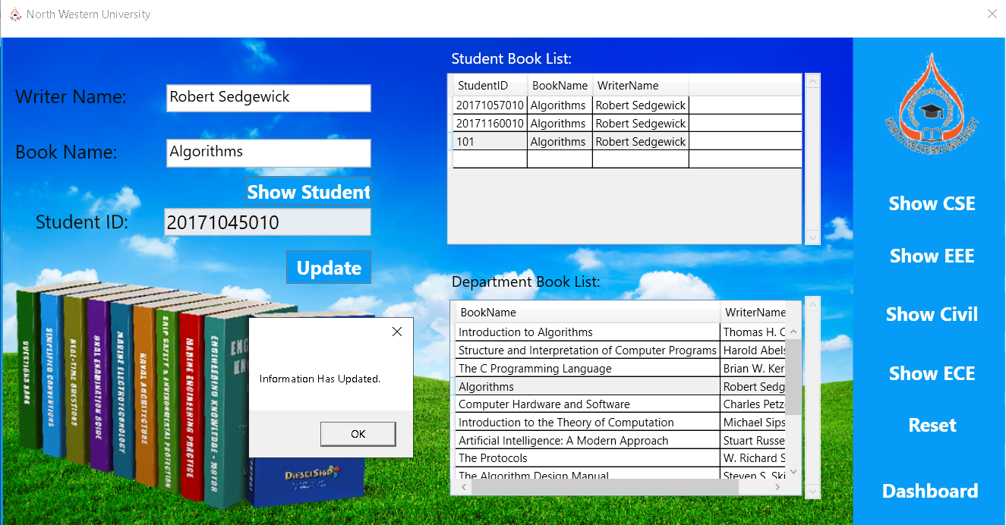
Update Student Book Window:
LIBRARY MANAGEMENT SYSTEM

Slide 26
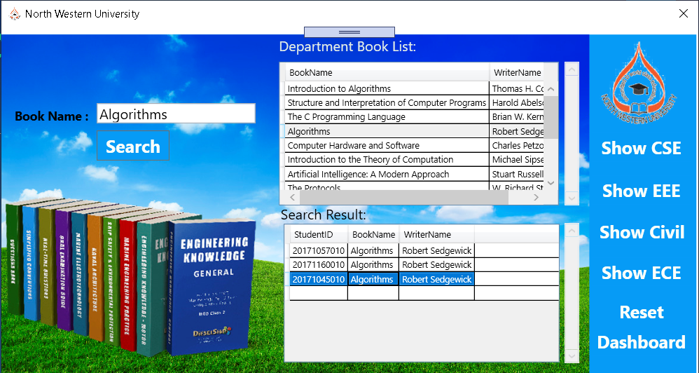
Search Book Window:
LIBRARY MANAGEMENT SYSTEM

Slide 27
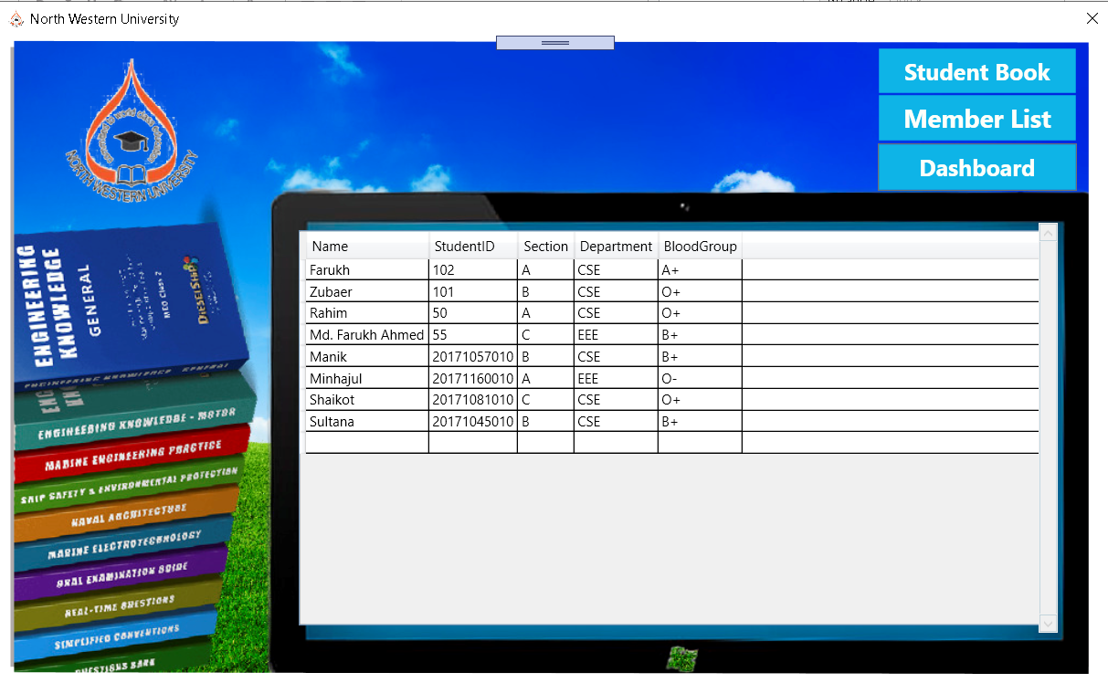
Show Record Window:
LIBRARY MANAGEMENT SYSTEM

Slide 28
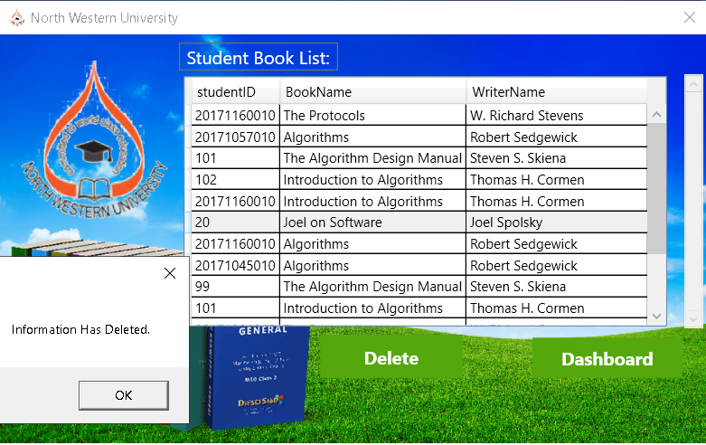
Delete Student Book Window:
LIBRARY MANAGEMENT SYSTEM

Slide 29
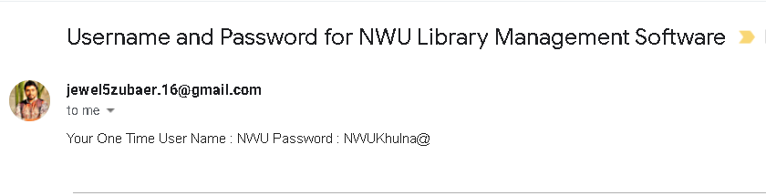
Forget Password Email:
LIBRARY MANAGEMENT SYSTEM

Slide 30
CONCLUSION
The project has been successfully completed and tested.
In the long term, this project will make the use of library more efficient, user friendly, easier and effective.
It is a real improvement over the existing manual system as it effectively overcome all the drawbacks of the existing system.
LIBRARY MANAGEMENT SYSTEM

Slide 31
THANK YOU
LIBRARY MANAGEMENT SYSTEM

